Slide 1
“Nebraska’s Water Future”
2018 Joint Annual Convention
Nebraska-Kansas Area Office
Federal Perspective
Aaron M. Thompson, Area Manager

Slide 2
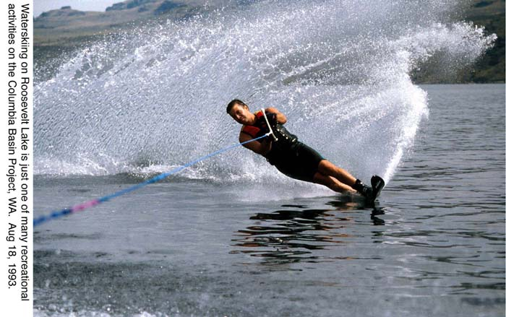
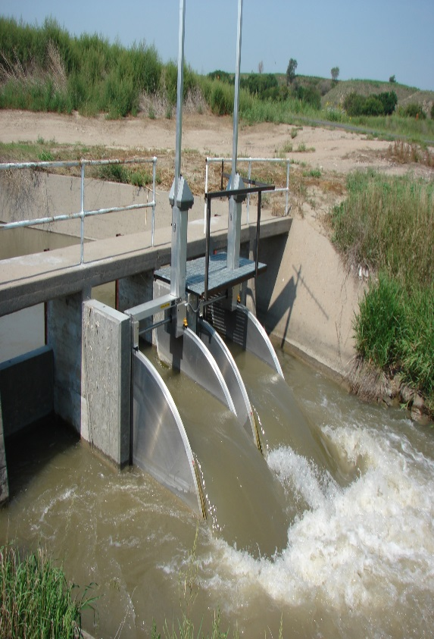
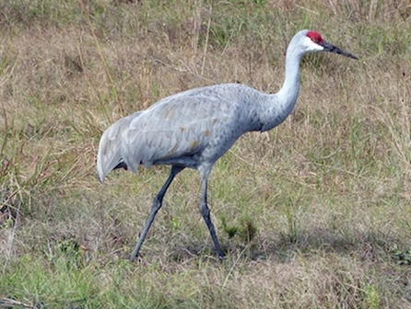
Reclamation’s Mission
Manage, develop, and protect water and related resources in an environmentally and economically sound manner.
Notes:
Reclamation is a Federal water resources agency established in 1902 to “reclaim” the arid west by bringing water and power resources.
Here’s our mission statement - Simply put, we manage, develop, and protect water in the interest of the American public.
2

Slide 3
WaterSMART Program: Supports Reclamation’s mission through collaboration with stakeholders to improve water management, increase conservation, and stretch scarce water resources
Notes:
Brief introduction of programs within WaterSMART
6 Programs, major on the money is in Water SMART Grants, Water Conservation and Efficiency.
RR Stakeholders Basin Wide Planning, we are discussing Water Markets;
Funding Opportunities
It is Open to Non-Federal Partners, so if you at this conference your most likely eligible.

Slide 4
WaterSMART Funding Opportunities
Application
Announced: October 2018 to March 2019.
Cost Share
50% (in kind contributions are allowed)
Completion
2-3 years depending on program group
Project benefits, stakeholder, implementation, nexus to BOR.
Amount ranges from $75k to $1 million
Funding
Selection
Consult: https://www.grants.gov

Slide 5
PROGRESS: WaterSMART PROGRAM IN NEBRASKA
(2012 TO PRESENT)
Program | # Agreements | BOR cost share ($ Million) | Status
Small Scale & Water Efficiency | 12 (2 in 2018) | 2.60 | 9 completed 3 on-going
WCFSP | 7 | 2.30 | 6 completed 1 on-going
Drought Response | 2 | 0.80 | 2 on-going

Slide 6
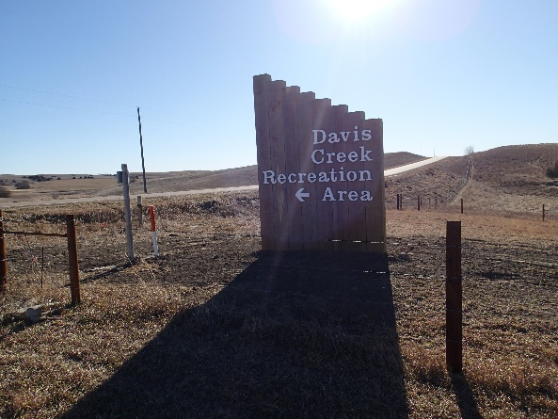
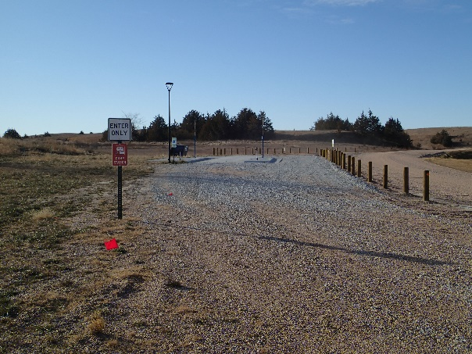
Nebraska –Kansas Area Office Recreation Enhancements at Davis Creek Reservoir Projects were managed and cost shared by the Lower Loup Natural Resource District
Phase I Improvements – 2016 - 2017
42 Modern RV Campsites with 50 amp Electrical Service
2 Group Picnic Shelters
Prefabricated Shower / Restroom Facility
Double Pit Latrine
All Facilities are ADA Compliant
Phase II Improvements – 2017 - 2018
Fish Cleaning Station
RV Dump Station
Wastewater Lagoon
Playground Equipment
Maintenance Headquarters Building
Inlet Latrine
Notes:
Reclamation Funding for both phases - $748,000.00
LLNRD Funding for both phases - $932,499.81
Total - $1,675,438.32
JEO Consulting Group Designed the Upgrades

Slide 7
Medicine Creek Resource Management Plan
The Nebraska-Kansas Area Office and the Nebraska Game & Parks Commission are in the process of updating the RMP for Medicine Creek Reservoir.

Slide 8
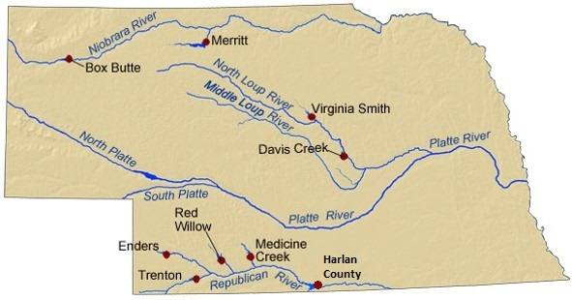
Federal Projects Administered by NKAO in Nebraska

Slide 9
WATER DELIVERY
Irrigation District | 2018 | 2019 (Projected)
Frenchman-Valley | 0.5 Inches | 0.5 Inches
Hitchcock & Red Willow | 0.0 Inches | 0.0 Inches
Frenchman-Cambridge | 3.5 Inches | 7.5 Inches
Nebraska-Bostwick | 4.5 Inches | 8.0 Inches
Mirage Flats | 2.0 Inches | 4.0 Inches
Ainsworth | 7.0 Inches | FULL SUPPLY
Twin Loups | 3.0 Inches | FULL SUPPLY
Notes:
Water Deliveries for some district's low due to wet year

Slide 10
NKAO Nebraska Reservoir Content
As of October 31, 2018
 | Elevation (ft) | Content (AF) | % Full | 2017 Content (AF)
BOX BUTTE | 3987.27 | 6,733 | 23 | 2,922
MERRITT | 2944.00 | 61,100 | 92 | 61,100
CALAMUS | 2238.08 | 92,227 | 77 | 93,616
DAVIS CREEK | 2056.18 | 13,642 | 44 | 13,311
SWANSON | 2738.09 | 53,785 | 49 | 48,293
ENDERS | 3082.51 | 9,017 | 21 | 8,412
HUGH BUTLER | 2568.77 | 18,538 | 51 | 15,087
HARRY STRUNK | 2362.09 | 28,024 | 81 | 19,234
HARLAN COUNTY | 1939.05 | 231,605 | 74 | 218,284
Notes:
David creek winter elevation Study, 8 feet above normal for three years, allow them more time for canal repair during the spring,
Harry Struck, no pumping form NCORP but bypassing inflow down to Harlan
HCL Supply 44K NBID and 54K for KBID; 13,000 ahead of this year of last year, but remember no NCORP pumping;

Slide 11
Bostwick MOA Revision
HCL Carry-over account balance from year to year
Inflows into HCL split
Account targets
Apportion more natural flow pickup at Courtland Diversion Dam to NBID
Notes:
-Rather than re-split as has been done historically
-40 % NBID 60 % KBID
-When an account reaches a target 100% of inflow goes to other district
-NBID receives less storage water but will receive more natural flow

Slide 12
Upcoming O&M Activities
2018/2019
Trenton Dam Outlet Works Pipe Repair
Glen Elder Outlet Works Painting
Norton Wire Rope Replacement
Webster Spillway Gate Rehab and Painting
2020 and beyond
Bonny Dam Outlet Works Painting
Webster Spillway Concrete Repair
Glen Elder Spillway Concrete Repair

