Slide 1
NDEQ & DHHS
Working
together
DHHS
NDEQ
David L Miesbach, PG
Groundwater Section Supervisor
NDEQ
NSIA/NSRA
Kearney, NE
November 20, 2018

Slide 2
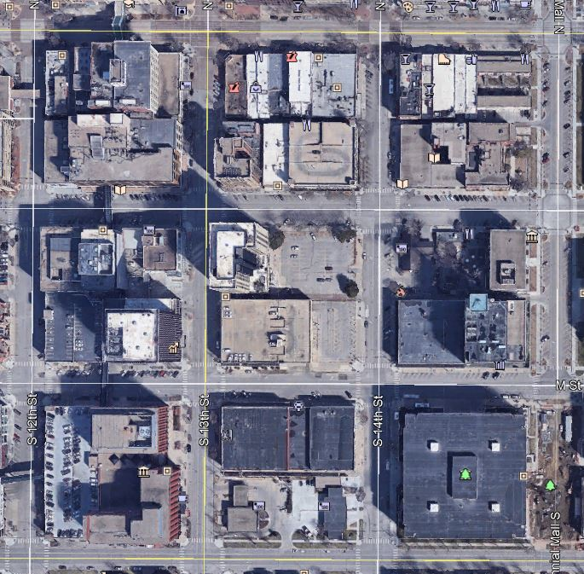
The
Move
Atrium
NSOB

Slide 3
Who
Moved in 2017

Slide 4
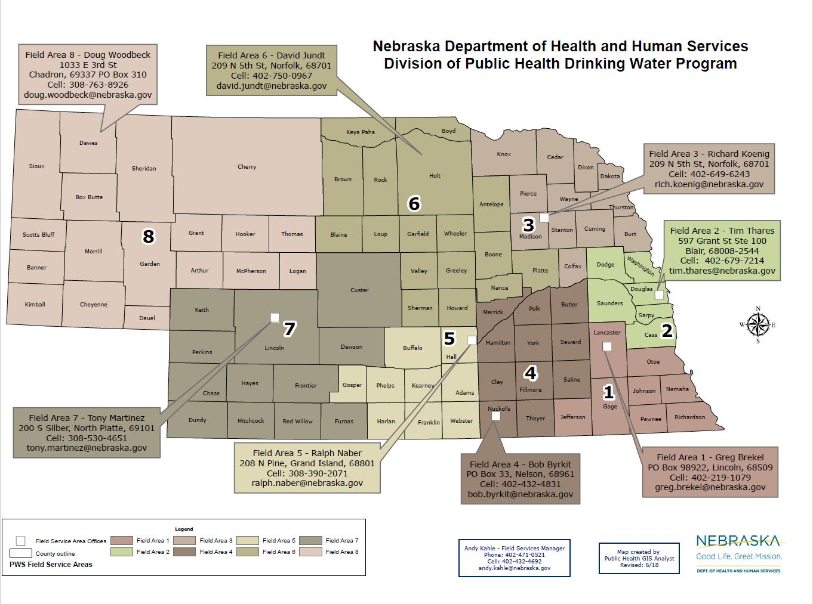
NDEQ Folks

Slide 5
Who 2
Moved in 2018

Slide 6
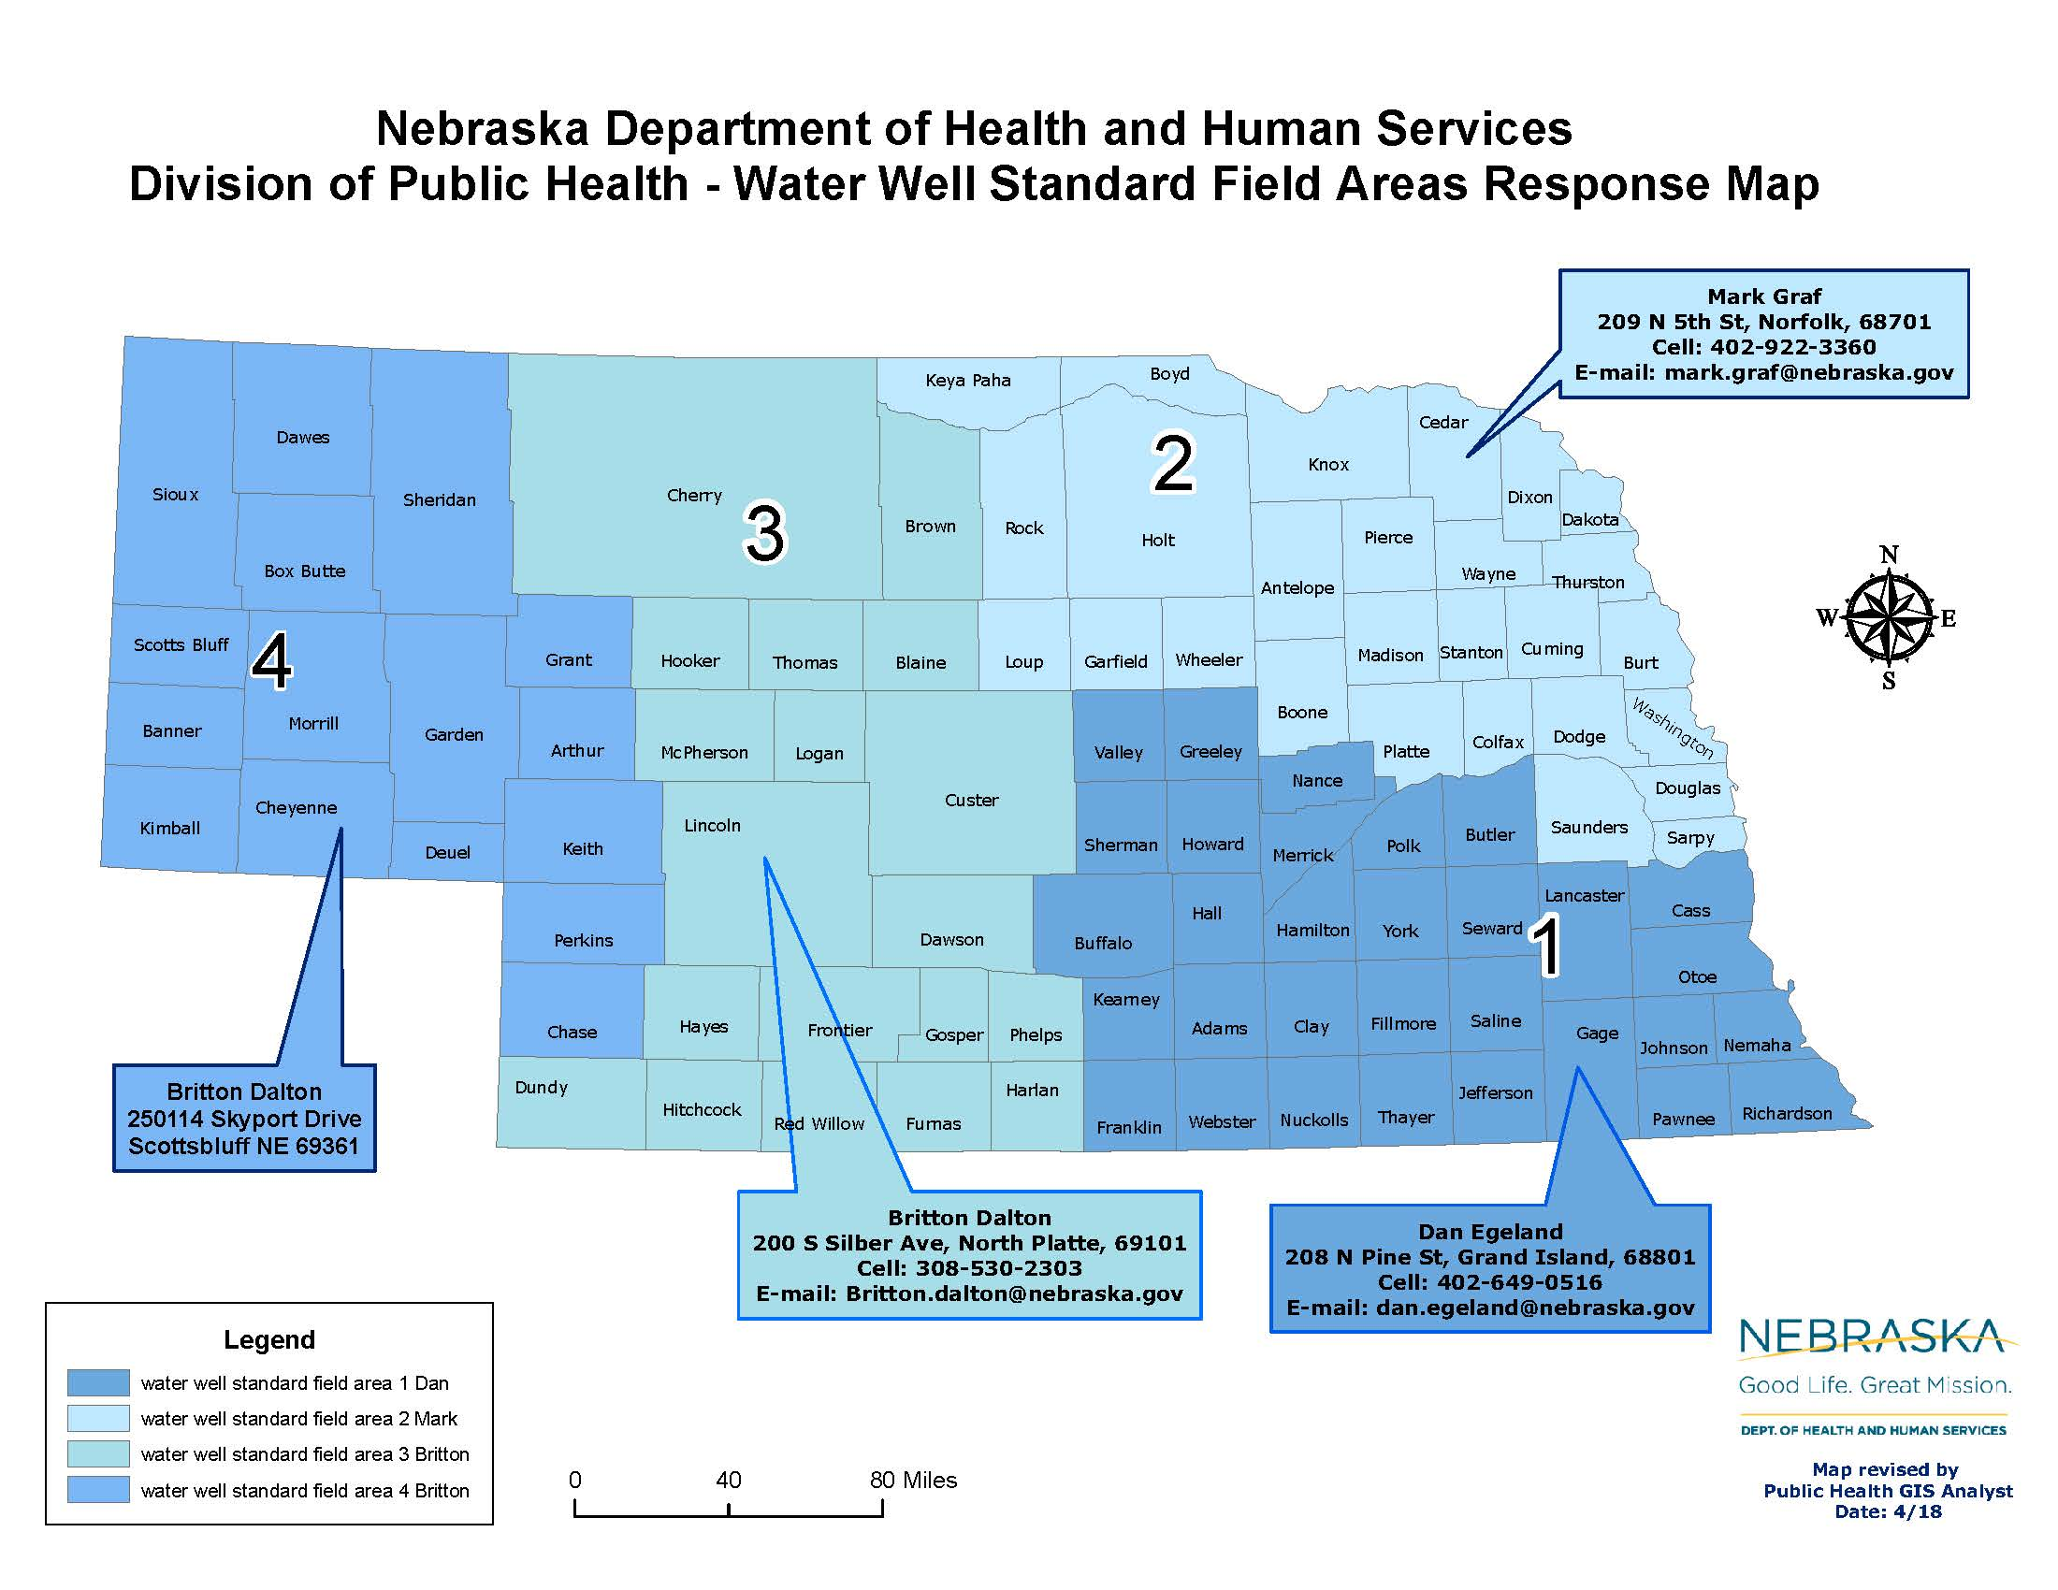
NDEQ Folks

Slide 7
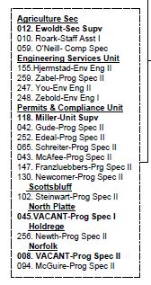
Questions?
(402) 471-4982
david.miesbach@nebraska.gov

